Slide 1
Smart Water Fountain System
Dylan Jarvis, Catherine Tan

Slide 2


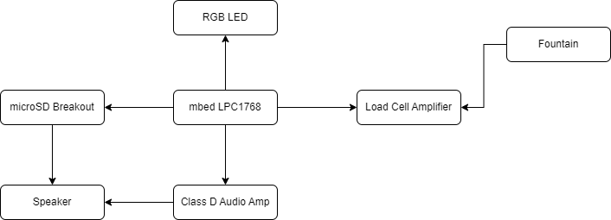

Overview
Purpose
Moose
Addresses lack of water level monitoring in current fountain
Block Diagram

Slide 3



Parts List
Rieux
4x Sparkfun Load Sensors - 50kg (Generic)
1x Sparkfun Load Sensor Combinator
1x Sparkfun Load Cell Amplifier HX711
1x Sparkfun Diffused LED - RGB 10mm
3x 100 Ohm Resistors
1x mbed LPC1768
1x Sparkfun Accessories Speaker - PCB Mount
1x Sparkfun Mono Audio Amp Breakout - TPA2005D1
1x Sparkfun microSD Transflash Breakout

Slide 4
Visual & Audible Alerts
Software
RTOS thread for speaker
PWMOut API for RGB LED
HX711 Library to interface with Load cells
0-33%
34-66%
67-100%
Low
Good
Full
Water level low!
Refill now
Water level
good!
Water level full!

Slide 5
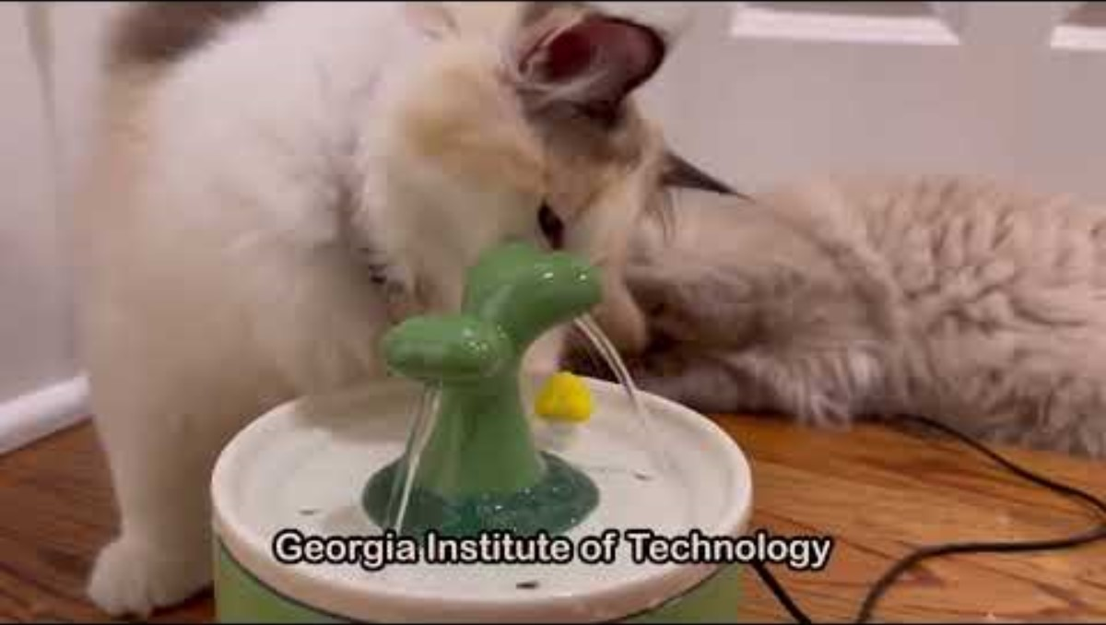
Demo
Mercury
Mercury is the closest planet to the Sun
Mars
Despite being red, Mars is a very cold place
Saturn
Saturn is the only planet with rings of them all

Slide 6
Benefits & Future Enhancements
Convenience
Visual alerts without physically checking inside fountain
Improved Kitty Health
Constant monitoring ensures access to fresh water
Bluetooth
Integrate Bluefruit App to receive alerts via phone/app
Quality Monitors
Additional pH sensors to assess water quality

